Slide 2


BACKGROUND
The study calculated that there are 13 deaths per year in a hospital due to overcrowding in the ED

Slide 3
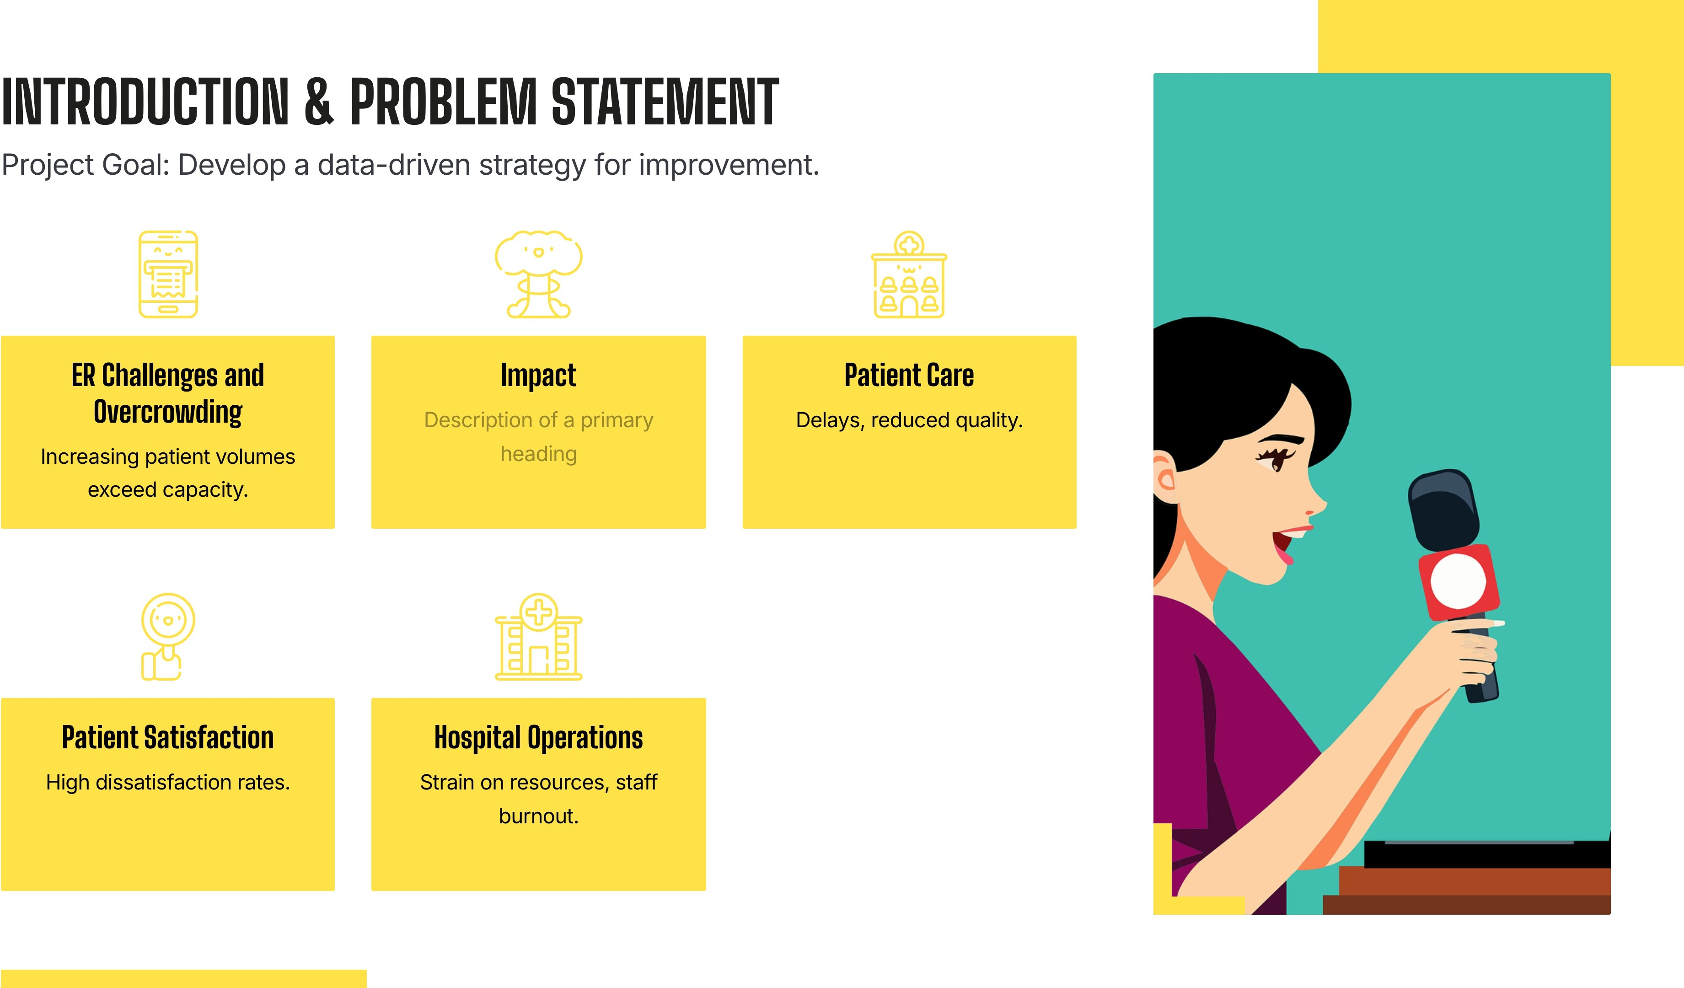

Slide 4
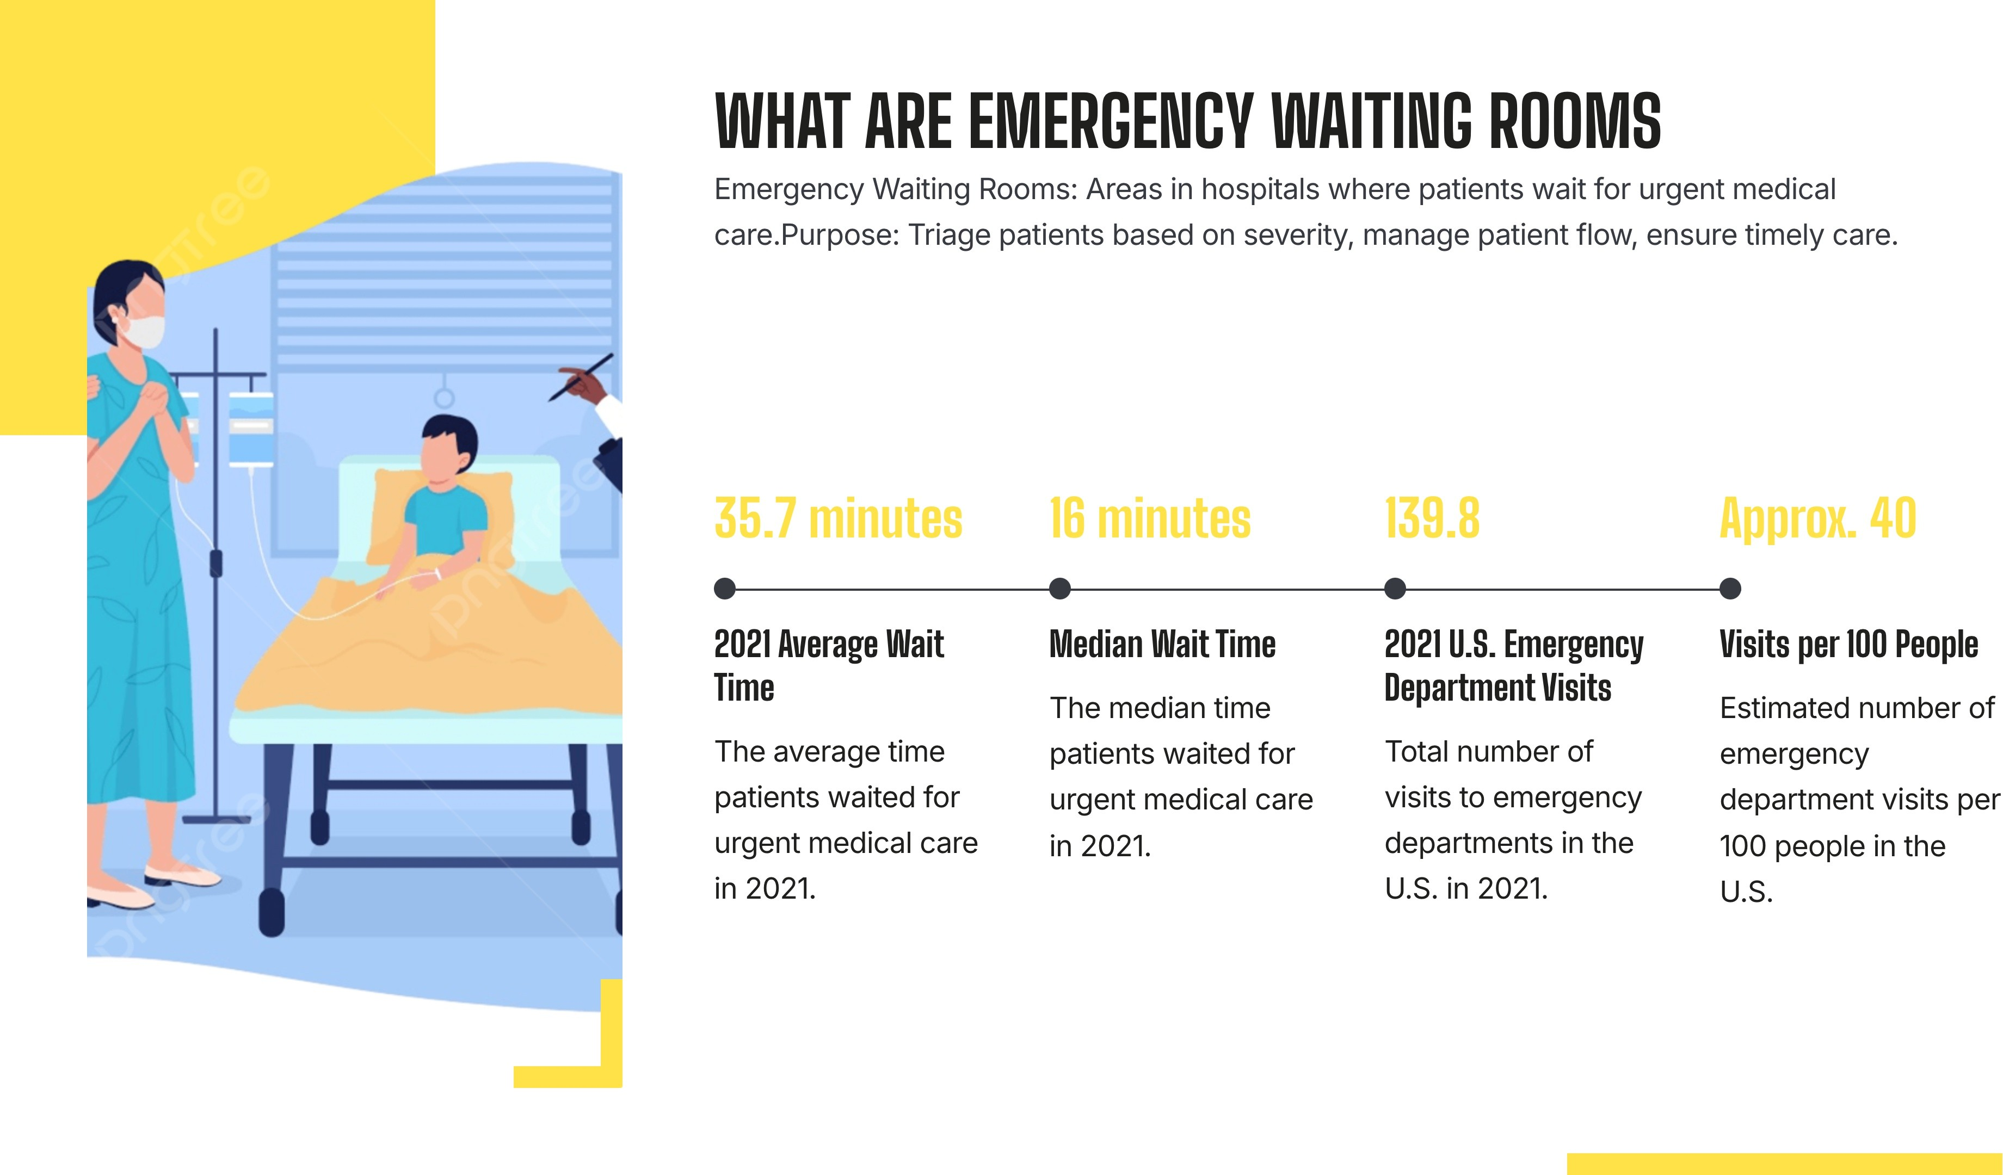

Slide 5
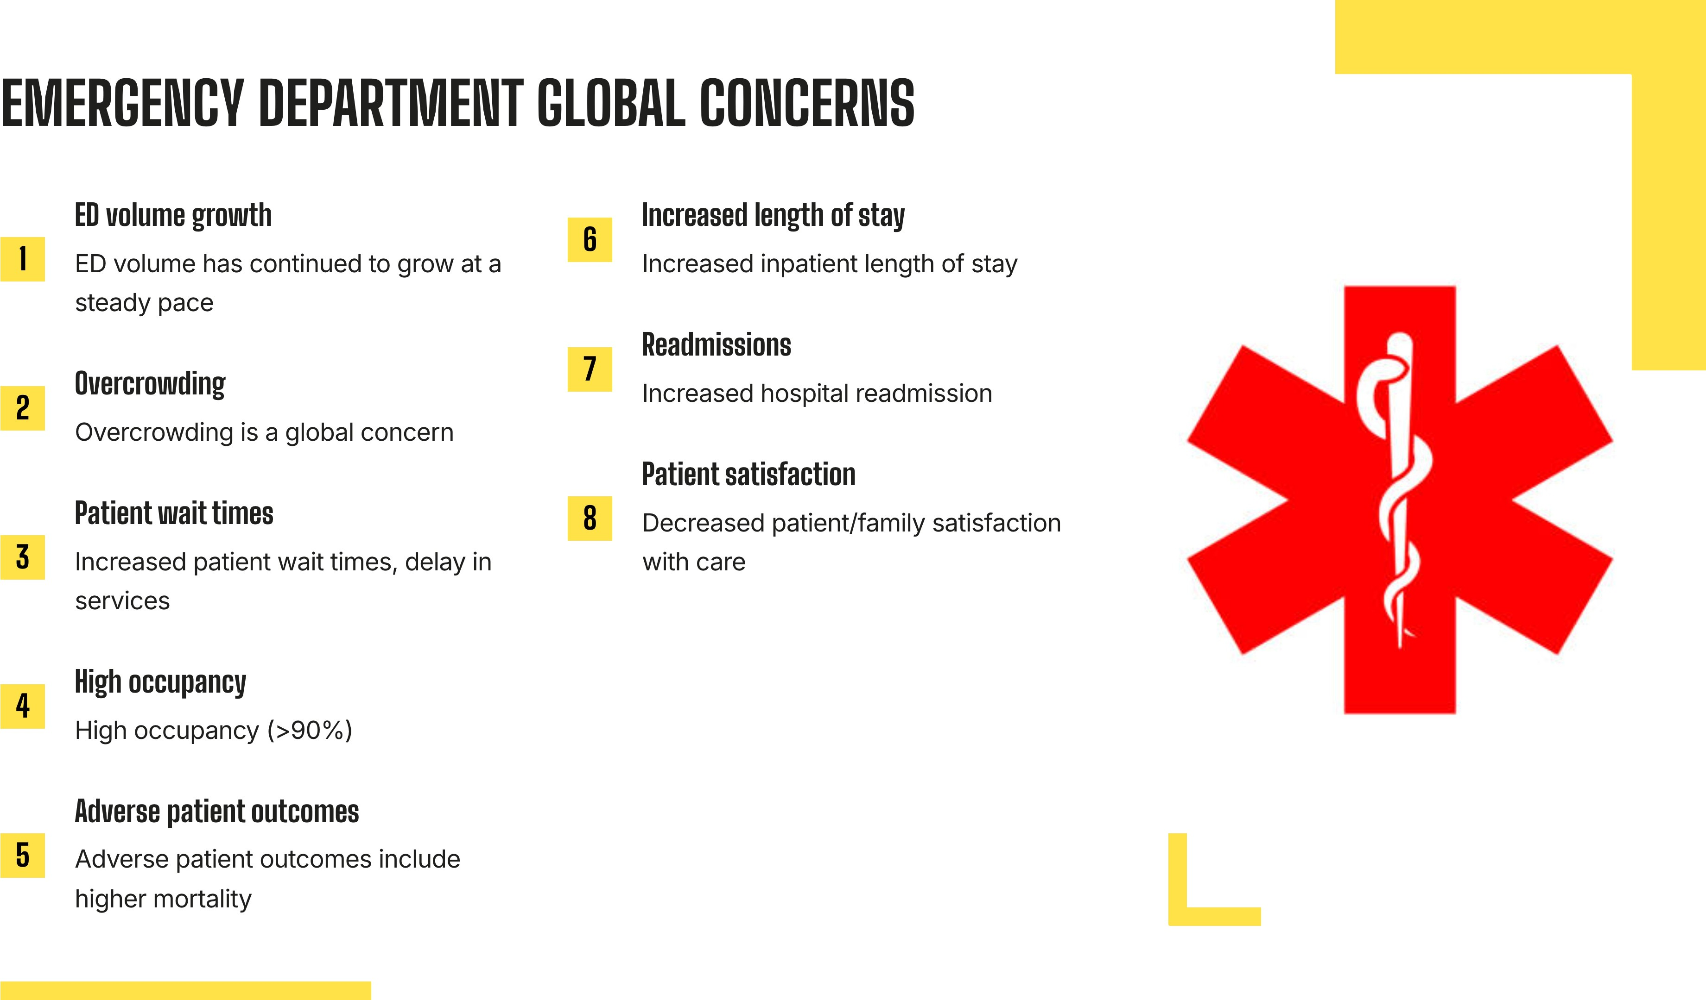

Slide 6


Slide 8
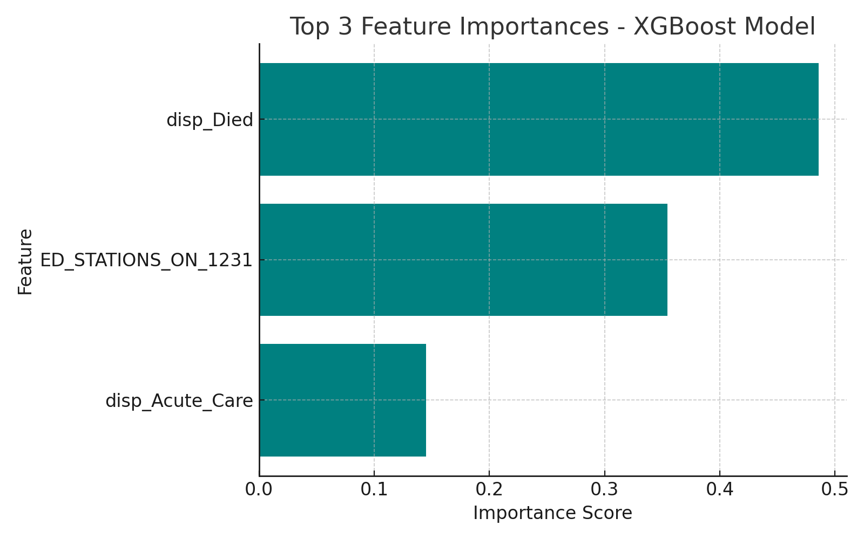
Machine learning methods
Feature Engineering:
Temporal Features: Day of the week, month
Resource Indicators: ED stations, acute care, patient arrivals

Slide 9
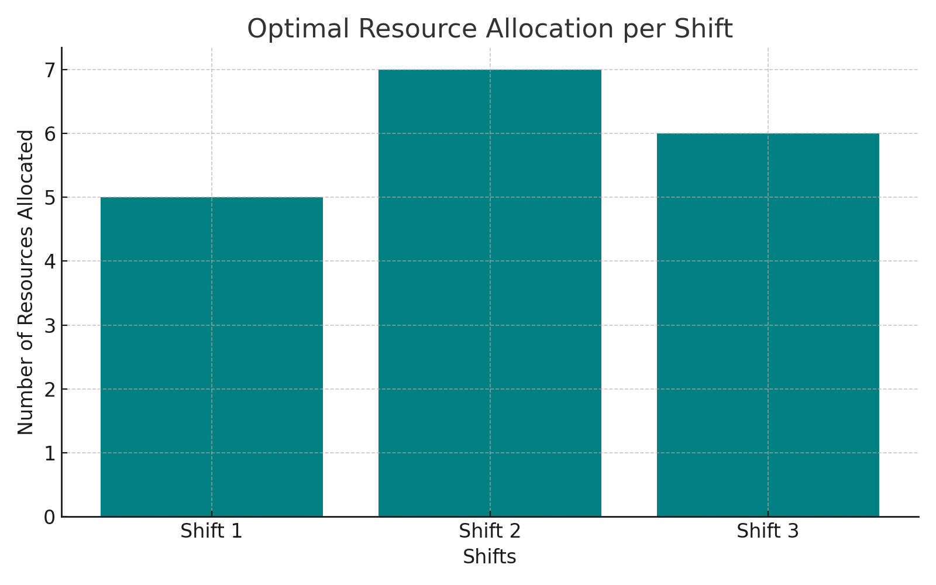
ER Resource Allocation Optimization
Objective: Minimize ER wait times by allocating resources across shifts effectively.
Model Structure:
Objective Function: Reduce total wait time.
Decision Variables: Number of resources (e.g., staff or ED stations) allocated per shift.
Constraints: Meet patient demand in each shift while staying within resource limits.
The LP model was solved using Python's scipy.optimize library, providing an optimal allocation that met patient demand while minimizing total wait times

Slide 10
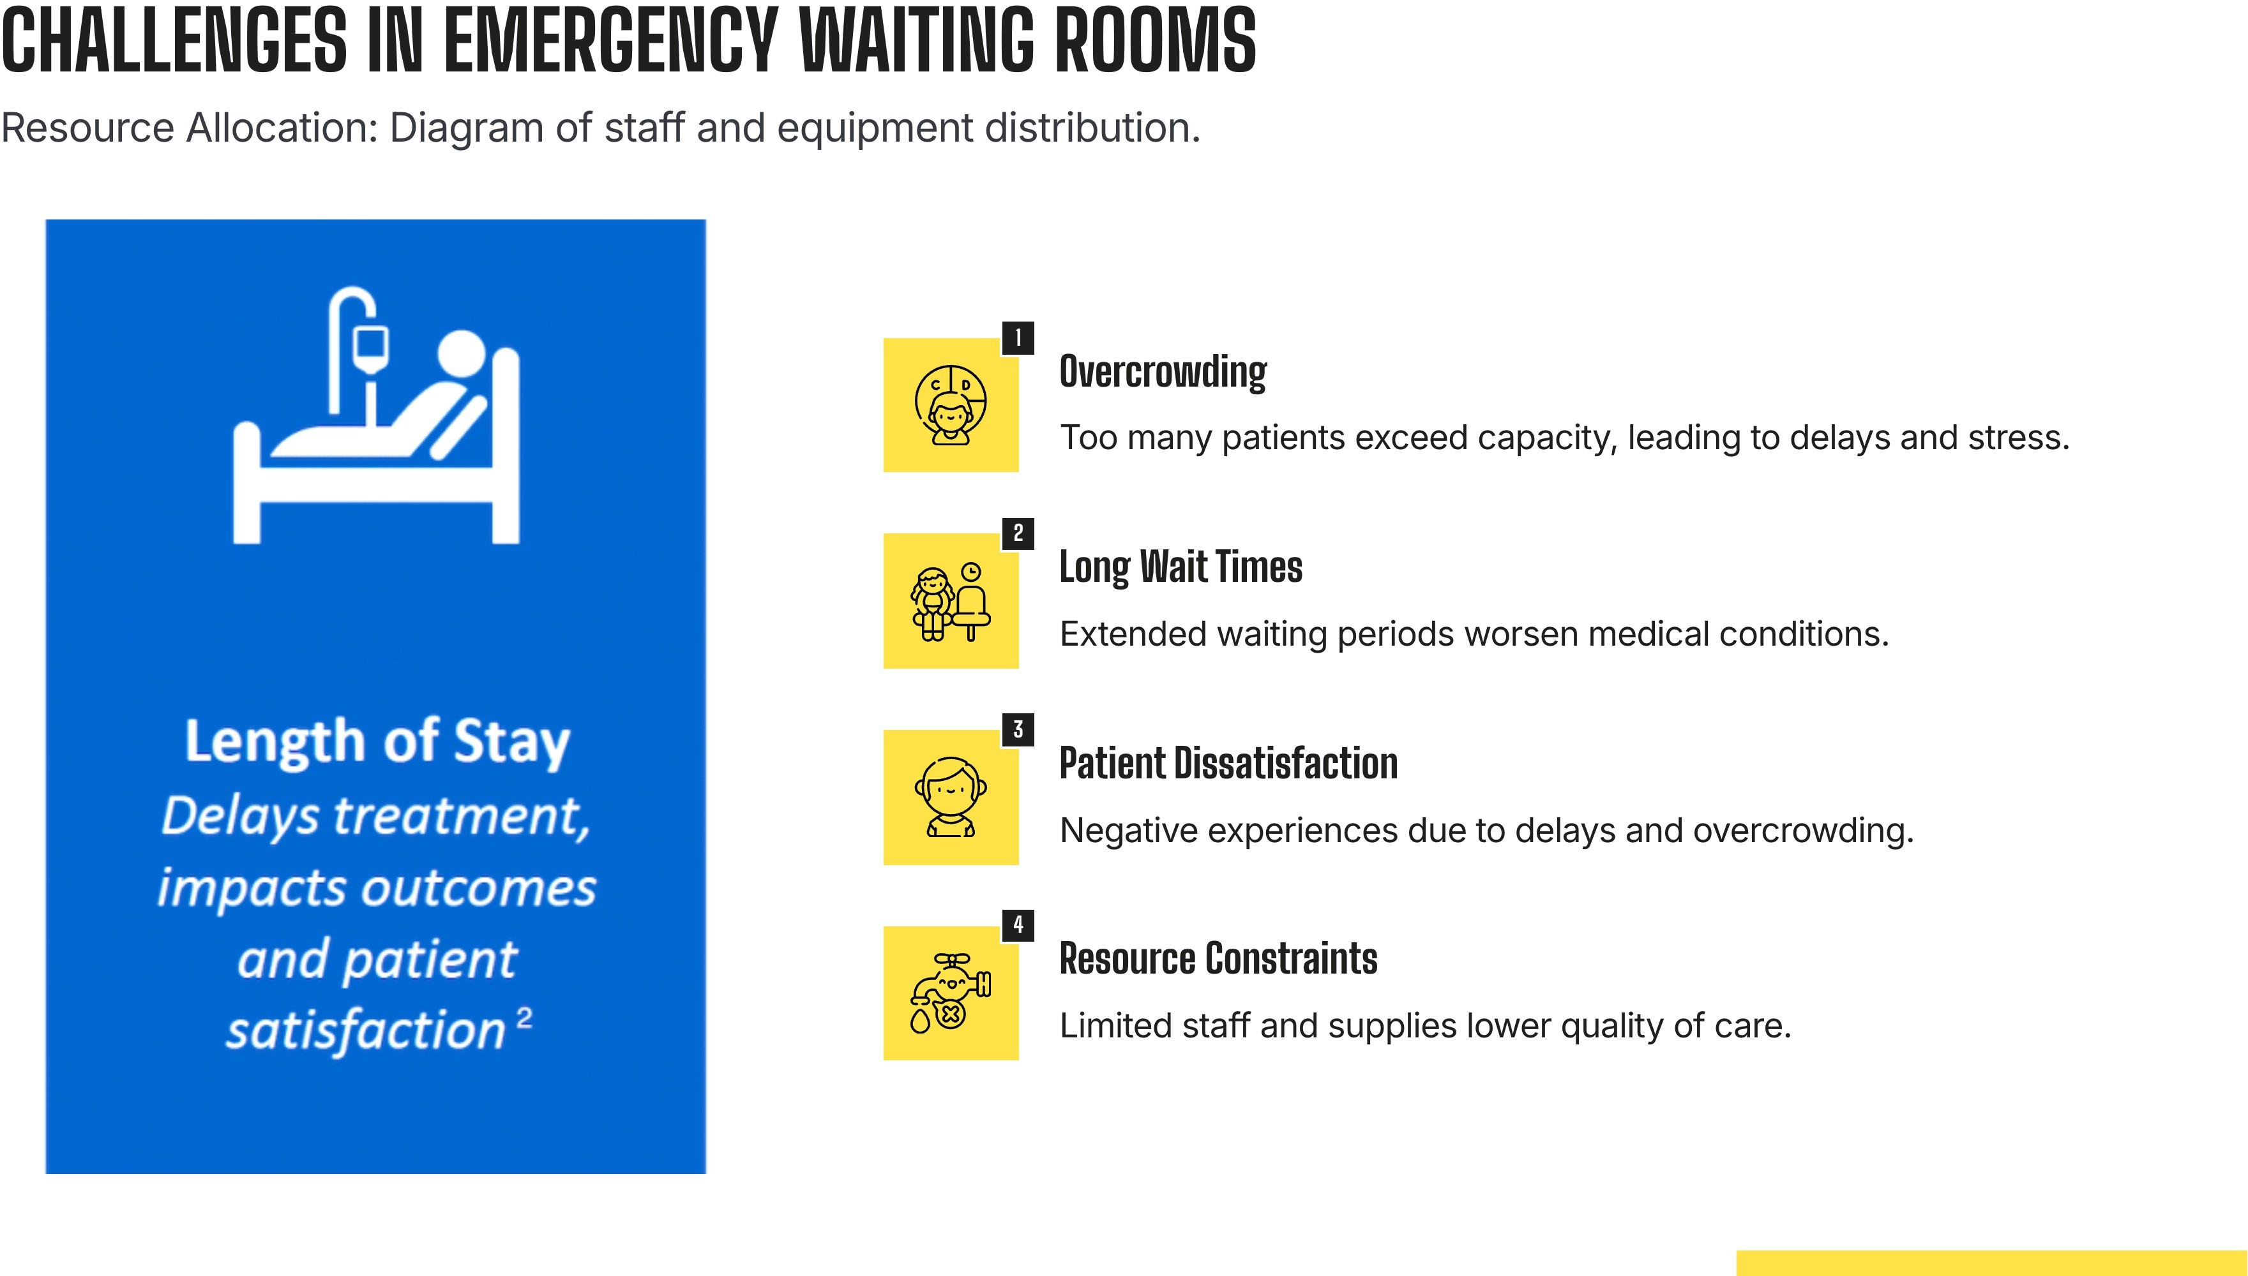

Slide 11
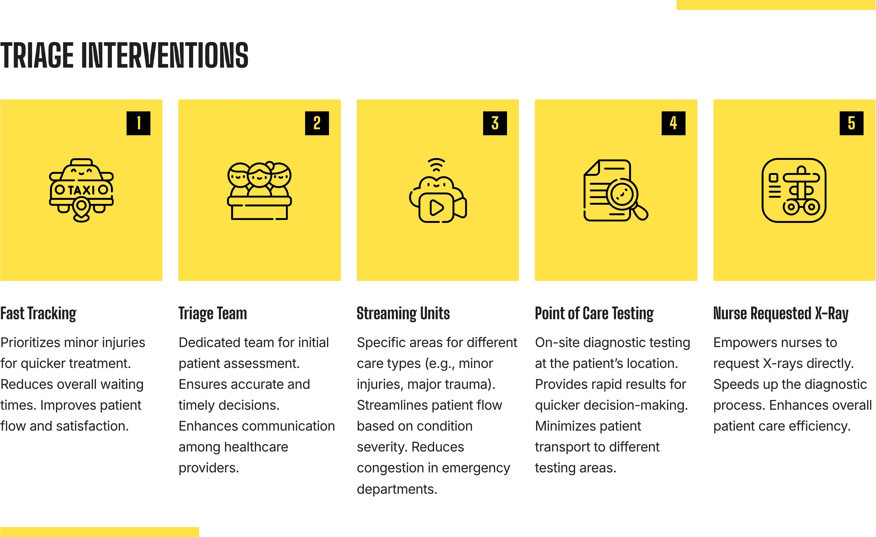

Slide 12


Slide 16


Slide 17
Reference:
Thompson (Feb. 7, 2024) As ER overcrowding worsens, a program helping to ease the crisis may lose funding. https://www.nbcnews.com/health/health-care/er-overcrowding-worsens-program-helping-ease-crisis-may-lose-funding-rcna135966
Marina(2022 Aug 25) Overcrowding in Emergency Department: Causes, Consequences, and Solutions—A Narrative Review
https://pmc.ncbi.nlm.nih.gov/articles/PMC9498666/#:~:text=The%20authors%20of%20this%20study,in%20the%20ED%20%5B28%5D.

